Slide 1

CPU SCHEDULING
Rachel Jarvi, Dominic Rendero, Harman Kaur, Kilraen Corbett

Slide 2
Project goals
Implement two CPU scheduling algorithms in OS161
Completely Fair Scheduler (CFS)
First-in first-out (FIFO)
Compare with default round-robin (RR) scheduler
Compare performance based on various test loads
Mix of short and long jobs
Mix of IO and CPU-heavy jobs
Various arrival times for jobs

Slide 3
Individual contributions
Rachel: CFS & some testing
Raen: Testing
Dominic: FIFO
Harman: Results analysis slides

Slide 4
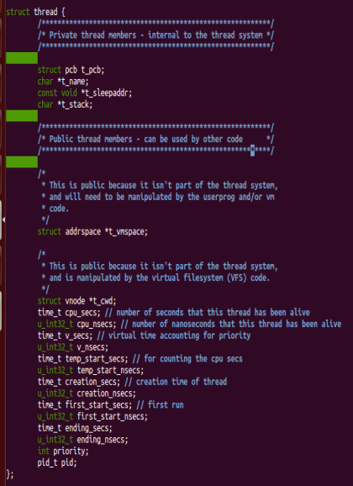
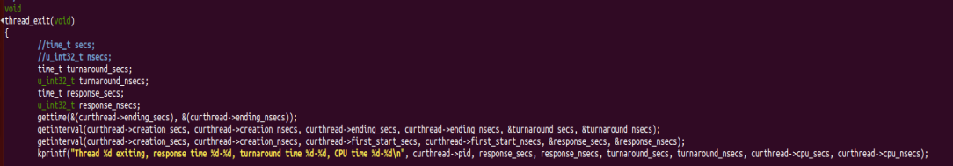
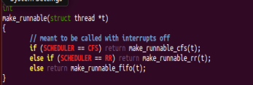
Overall structure
Threads: tracking timestamps
Keep track of thread starting time, total CPU time, etc: add fields in thread.h
Update time in mi_switch()
Print out statistics during thread_exit()
Switching between schedulers
scheduler.c: switching between schedulers based on #define
scheduler_cfs.c, scheduler_rr.c, scheduler_fifo.c: actual scheduling logic
Rbtree implementation: rbtree.c
Thread.h
scheduler.c

Slide 5
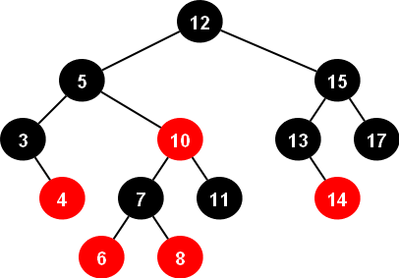
cfs
Base algorithm
Chosen process gets to run on CPU for min(Tmin, T/N) time period
N = number of processes in ready queue
T = base time slot
Tmin = minimum time slot
During context switch, next process is chosen
Next process = process with lowest virtual runtime
Where virtual runtime = runtime / process weight value (priority)
Red-black tree
O(log(n)) operations
Our implementation
To reduce overhead on OS161, always use Tmin as time slice
Default process weight value = 1, can be set upon thread initialization

Slide 6
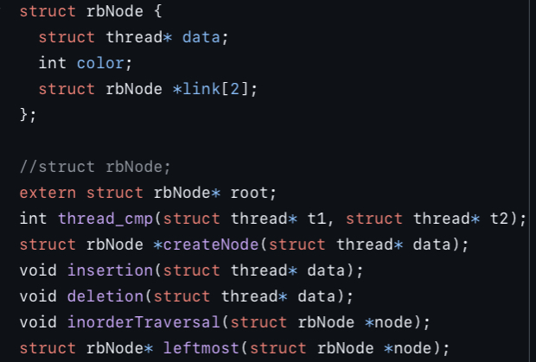
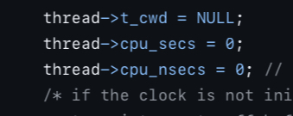
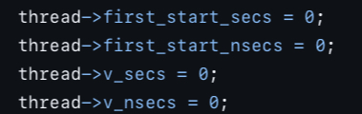
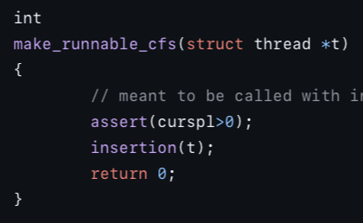
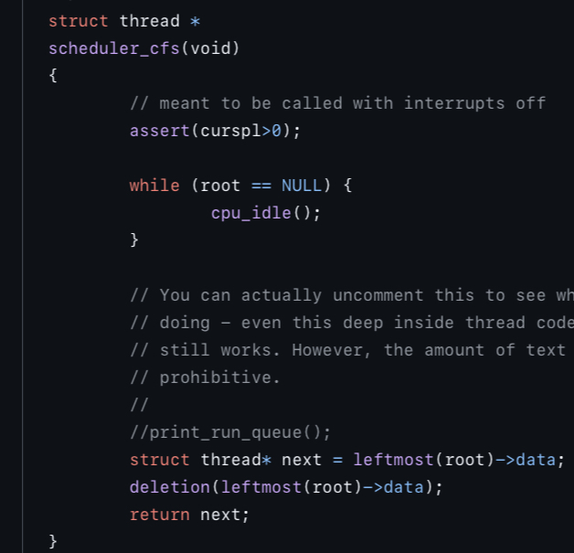
Cfs implementation
Red-black tree as ready queue
Don't reinvent the wheel; adapted code found on Programiz
Allows O(log(n)) insertion and find operations
When thread is created, initialize virtual cpu time to zero
During context switch
If current thread is runnable, insert into the rbtree
Remove and return leftmost entry in rbtree as next job
When thread exits
Print statistics
Delete thread from rbtree
Every node is either red or black.
All NIL nodes (figure 1) are considered black.
A red node does not have a red child.
Every path from a given node to any of its descendant NIL nodes goes through the same number of black nodes.

Slide 7
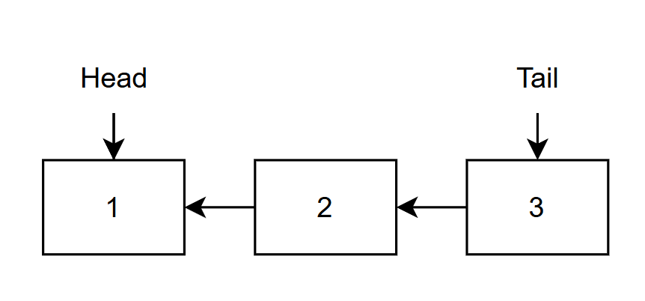
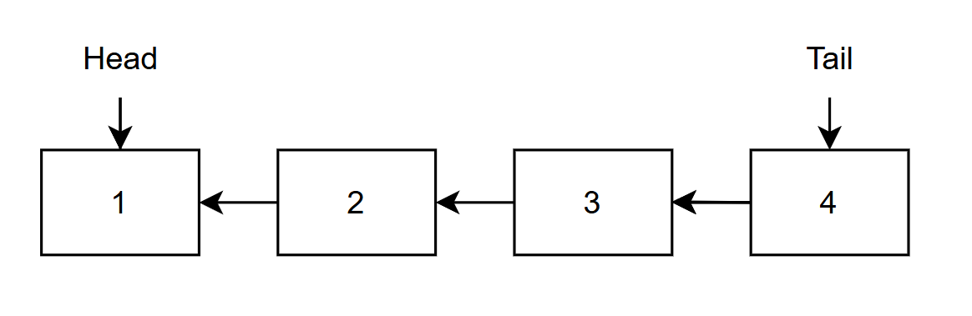
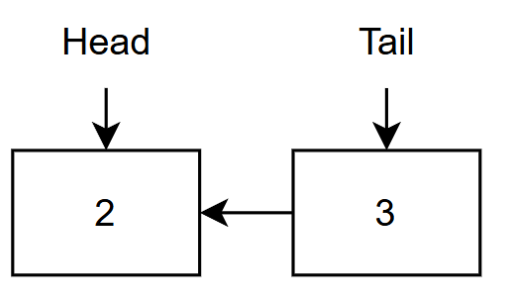
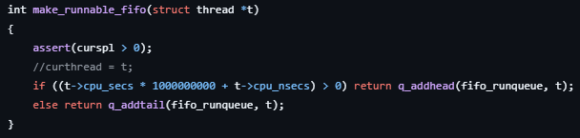
FIFO
Normal flow
Create a "First-in-first-out" Scheduler
Utilizes a queue to order threads
Modified RR scheduler
Add new threads to the tail
Handle interrupts by checking the runtime on the thread
Interrupt handler

Slide 8
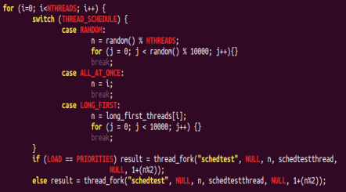
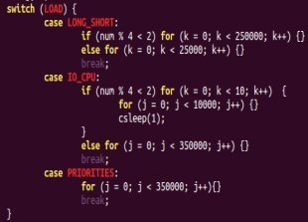
TEST SUITE
Kernel level tests
sy4 on command line
Testing mix of I/O and CPU-intensive jobs
CPU jobs: Spin in a for loop
I/O jobs: Alternate between for loops and sleeping
Testing mix of long and short CPU jobs
Long jobs are 10x longer than short jobs
I/O jobs are the same length
Testing mix of delays in-between jobs
32 Threads (Jobs) per test

Slide 9
Test Suite
3 Types of Thread
RANDOM – Random job type with random delay
ALL_AT_ONCE – No delay in-between release of jobs
LONG_FIRST – Forces long CPU jobs first
3 Types of Loads
LONG_SHORT – Alternating CPU jobs
IO_CPU – Alternating I/O and CPU jobs
PRIORITIES – Constant CPU job length
PRIORITIES was tested only with ALL_AT_ONCE
LONG_FIRST as tested only with LONG_SHORT

Slide 10
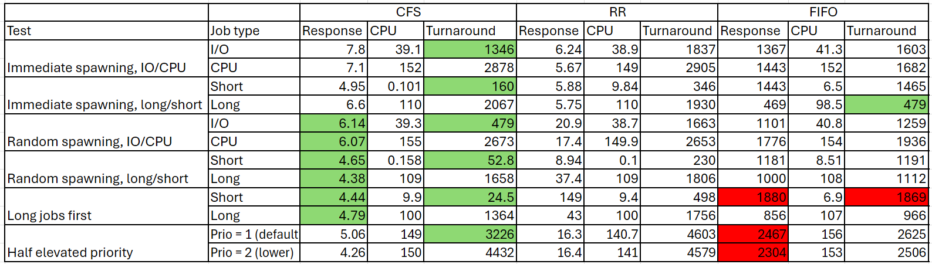
Test results
Median times (in ms) for different testing schemas, schedulers, and tests.

Slide 11
Test Results Analysis
We evaluated the Completely Fair Scheduler (CFS), First-In-First-Out (FIFO), and Round Robin (RR) on response time and turnaround time across I/O-bound, CPU-bound, and mixed tasks. The results highlight CFS’s consistent efficiency in diverse workloads, FIFO’s limitations with varied tasks, and RR’s balanced performance.
Completely Fair Scheduler (CFS) - Demonstrated efficient resource allocation and low response times across varied workloads.
Response Time: CFS achieved the lowest average response time at 5.5 ms, with a minimum of 4.4 ms in I/O-bound scenarios, efficiently prioritizing yielding tasks.
Turnaround Time: CFS exhibited the lowest turnaround times in short and IO-bound tasks. The median is 319.5 ms in short tasks and the maximum is 3226 ms in CPU-intensive tests, making it efficient for mixed workloads.

Slide 12
Test Results Analysis, CONT'd
First-In-First-Out (FIFO)- Struggled with task variety, showing high delays due to non-preemptive scheduling.
Response Time: FIFO showed the highest response times, with an average of 1573 ms and a peak of 2467 ms. The "convoy effect" caused delays, as short tasks were held up by long-running processes.
Turnaround Time: FIFO recorded a maximum turnaround time of 1869 ms even for short tasks, highlighting its limitations in handling diverse task lengths effectively.
Round Robin (RR)- Provided balanced performance
Response Time: RR had a balanced response time averaging 34.5 ms, managing short tasks well with a median of 12.6 ms.
Turnaround Time: RR's median turnaround for long tasks was 1080.5 ms, with a maximum of 4603 ms in CPU-heavy scenarios, performing better than FIFO but not as well as CFS for I/O-bound tasks.

Slide 13
Conclusion
This project implemented and compared two CPU scheduling algorithms, Completely Fair Scheduler (CFS) and First-In-First-Out (FIFO), alongside the default Round Robin (RR) in OS161, to assess their performance under varied workloads.
CFS emerged as the most efficient scheduler, handling mixed workloads of short and long tasks, as well as I/O and CPU-heavy jobs, with the lowest average response time (5.5 ms). Its ability to adapt to different arrival times and prioritize yielding tasks made it ideal for environments requiring responsiveness and fairness across dynamic workloads.
FIFO showed limitations in handling mixed and varied arrival times, as its non-preemptive nature led to high response times and delayed shorter tasks behind longer ones.
Round Robin (RR) provided balanced performance that generally falls in-between the CFS and FIFO approaches on most tasks.

